Slide 1
capstone
Trails Team

Slide 2
html, css, typescript
Frontend - Angular
API #1: Get image
imagegroupid
images[] : array of 3
species
animalcount
API #2: Submit Annotation
imagegroupid
species
animalcount
images
2 apis
S3 public bucket - images
API Server - Flask
python, db calls, model calls
DB
{
"imagegroupid" : "333",
"images" : [
https://panoptes-uploads.zooniverse.org/subject_location/60b9fcfa-20c0-45db-823a-4ce78ea1d740.jpeg,
https://panoptes-uploads.zooniverse.org/subject_location/ed1c603b-c741-44ad-ae11-3cdf404a3fb5.jpeg,
https://panoptes-uploads.zooniverse.org/subject_location/4804d5e2-3a2e-4ce6-b7c5-cc9397bb4a59.jpeg
],
”species" : "bobcat"
"animalcount" : 4,
}

Slide 3
DB
event_images
event_id: primary key
image_group_id: alphanumeric
image_url_1: alphanumeric (s3 bucket)
image_url_2: alphanumeric (s3 bucket)
image_url_3: alphanumeric (s3 bucket)
species_name: alphanumeric
count: numeric
blank_image: boolean
load_date: datetime (+ who columns)
event_annotations
1 : many
event_annotation_id: primary key
event_id: foreign key
image_group_id: alphanumeric
species_name: alphanumeric
count: numeric
blank_image: boolean
annotation_date: datetime
userid: alphanumeric (+ who columns)
Image_id: 1
Image_event_id: 32243
Image_url_1: http://…amazons3/32243_0.jpeg
Image_url_2: http://…amazons3/32243_1.jpeg
Image_url_3: http://…amazons3/32243_2.jpeg
Species: deer
Count: 2
….

Slide 4
html, css, typescript
Frontend - Angular
images
2 apis
S3 public bucket - images
API Server - Flask
python, db calls, model calls
DB

Slide 5
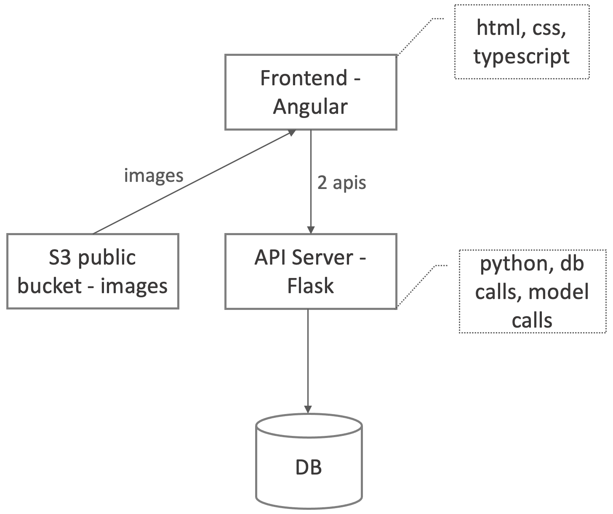
What gets measured,
gets managed

Slide 6


YOLOv5 inference
script
ensemble
script
efficientnet inference
script
DB
write
results
read
megadetector inference
script
GET
api
write
POST
api
angular single
page app
backend

Slide 7

YOLOv5 inference
script
ensemble
script
efficientnet inference
script
DB
write
results
read
megadetector inference
script
GET
api
write
POST
api
angular single
page app
partially completed
backend

Slide 8
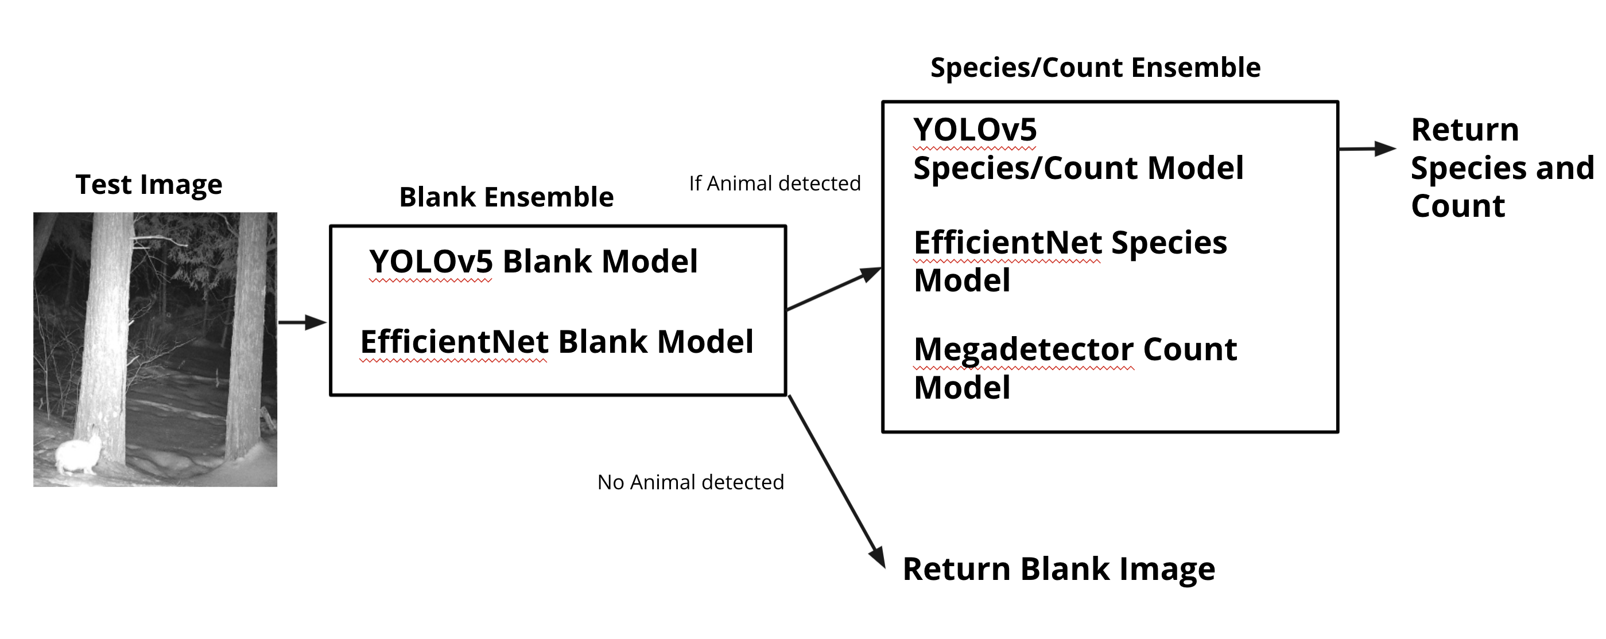

Slide 9
table:
event_annotations
3
YOLOv5 inference
script (blank)
model_id = 1
table:
model_outputs
1
efficientnet inference
script (blank)
ensemble
script
model_id = 2
table:
event_images
2
model_id = 3
YOLOv5 inference
script (species)
efficientnet inference
script (species)
write
results
model_id = 4
table:
ground_truth
4
megadetector inference
script (species)
Draft algorithm
model_id = 5
n
Database tables
partially completed

Slide 10
event_images
event_annotations
event_id: primary key
image_group_id: alphanumeric
image_url_1: alphanumeric (s3 bucket)
image_url_2: alphanumeric (s3 bucket)
image_url_3: alphanumeric (s3 bucket)
species_name: alphanumeric
count: numeric
blank_image: boolean
load_date: datetime (+ who columns)
event_annotation_id: primary key
event_id: foreign key
image_group_id: alphanumeric
species_name: alphanumeric
count: numeric
blank_image: boolean
annotation_date: datetime
userid: alphanumeric (+ who columns)
1 : many

Slide 11
Table: Model_Output
model_ouput_id | int
model_id | int
image_group_id | alphanumeric
image_id_1 | alphanumeric
image_id_1_species_name | alphanumeric
Image_id_1_conf | string
image_id_1_count | int
image_id_1_blank | boolean
image_id_1_detectable | boolean
image_id_1_bbox | alphanumeric
image_id_2 | alphanumeric
image_id_2_species_name | alphanumeric
Image_id_2_conf | string
image_id_2_count | int
image_id_2_blank | boolean
image_id_2_detectable | boolean
image_id_2_bbox | alphanumeric
image_id_3 | alphanumeric
image_id_3_species_name | alphanumeric
Image_id_3_conf | string
image_id_3_count | int
image_id_3_blank | boolean
image_id_3_detectable | boolean
image_id_3_bbox | alphanumeric
load_date | datetime
detectable -> image is blur or animal too close to camera

Slide 12
SSWI000000020163117A
SSWI000000020163117B
SSWI000000020163117C

